Slide 1

Car Classification
using Transfer Learning and Siamese Network
Youbin Mo, Xiaoyin Yang, Xiangyi Dong, Xiaochen Liu

Slide 2
Outline
Background Introduction
Methods and Models
Transfer Learning and ResNet
Siamese Network and CNN
Experiments and Results
Conclusion
Reference

Slide 3
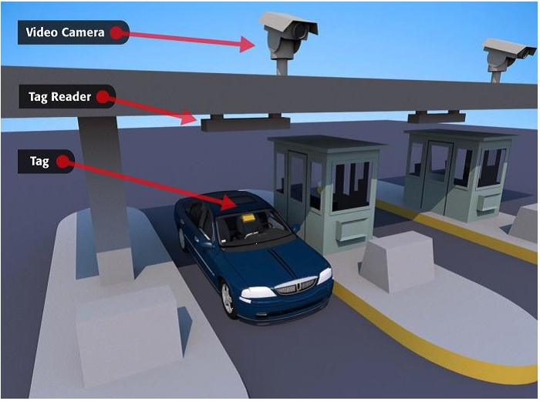
Background Introduction
Potential Car Classification application:
Surrounding vehicle detection
Electronic toll
Vehicle plate information check
Problems we want to solve:
Improve classification speed → transfer learning
Further improve classification accuracy → siamese network
Notes:
Currently, self-driving has been a really interesting topic and object detection and classification play a fundamental role in it. The reason we chose this topic at first is we want to start with the basic car classification and also came up with some potential applications, e.g., detect the car type around your car in a car accident, or electronic toll to scan car type, or to check whether the plate registration information is consistent with the real car type. In order to achieve these application, we need a very accurate and fast car classification method. So there are 2 problems we want to solve in this project is:

Slide 4
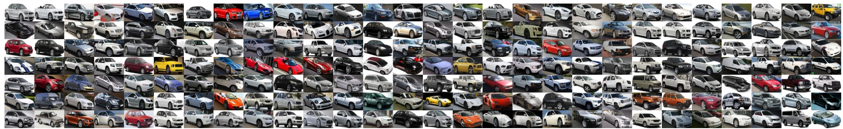
Stanford Car Dataset
- 16,185 images of 196 classes of cars.
- The data is split into 8,144 training images and 8,041 testing images, where each class has been split roughly in a 50-50 split.
- Classes are typically at the level of Make, Model, Year,
e.g. 2012 Tesla Model S or 2012 BMW M3 coupe.
*Krause, Jonathan, et al. "3d object representations for fine-grained categorization."
Notes:
Stanford car dataset. Around 16k. Make, model, year. Part of the dataset.

Slide 5
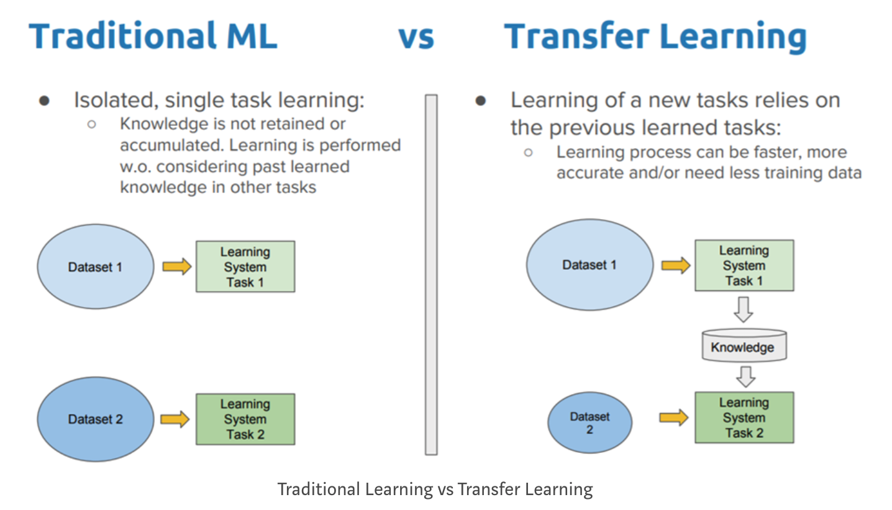
Method -- Transfer learning
Transfer learning: shortcuts the whole training process from scratch by using a pre-trained model’s weights and reusing it in a new related model.
Advantages: improve speed effectively.

Slide 6
Model -- Pretrained ResNet
A block of learning layers
Image
x
Block #1
Weight Layer
F(x)
ReLU
Block #2
Identity
Weight Layer
⠂⠂⠂
F(x)+x
Block #34
Average Pool
ReLU
Output
34-blocks Residual
Notes:
Why using resnet?

Slide 7
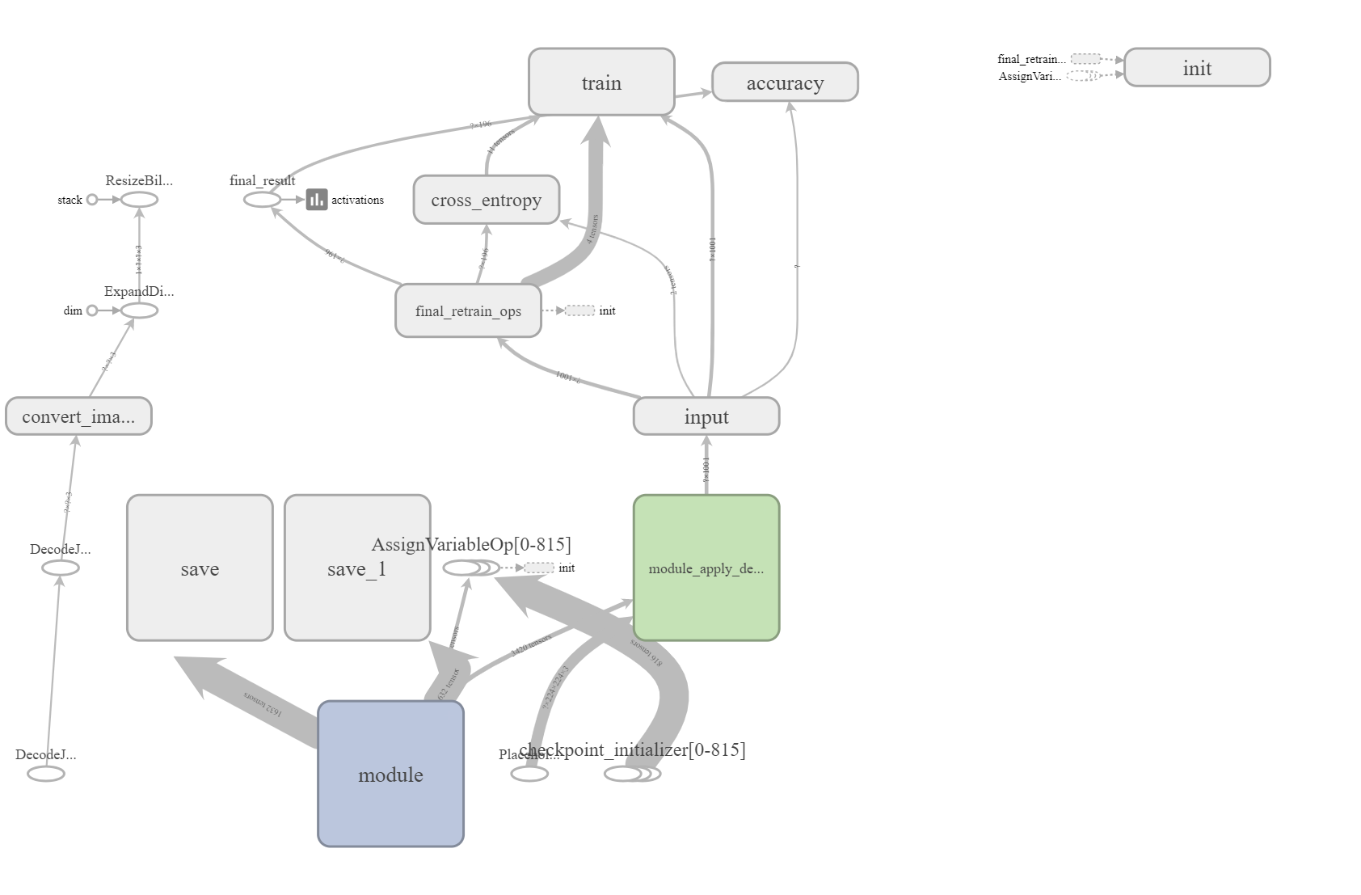
Model Structure
Pretrained Resnet Architecture*
*He, Kaiming, et al. "Deep residual learning for image recognition."

Slide 8
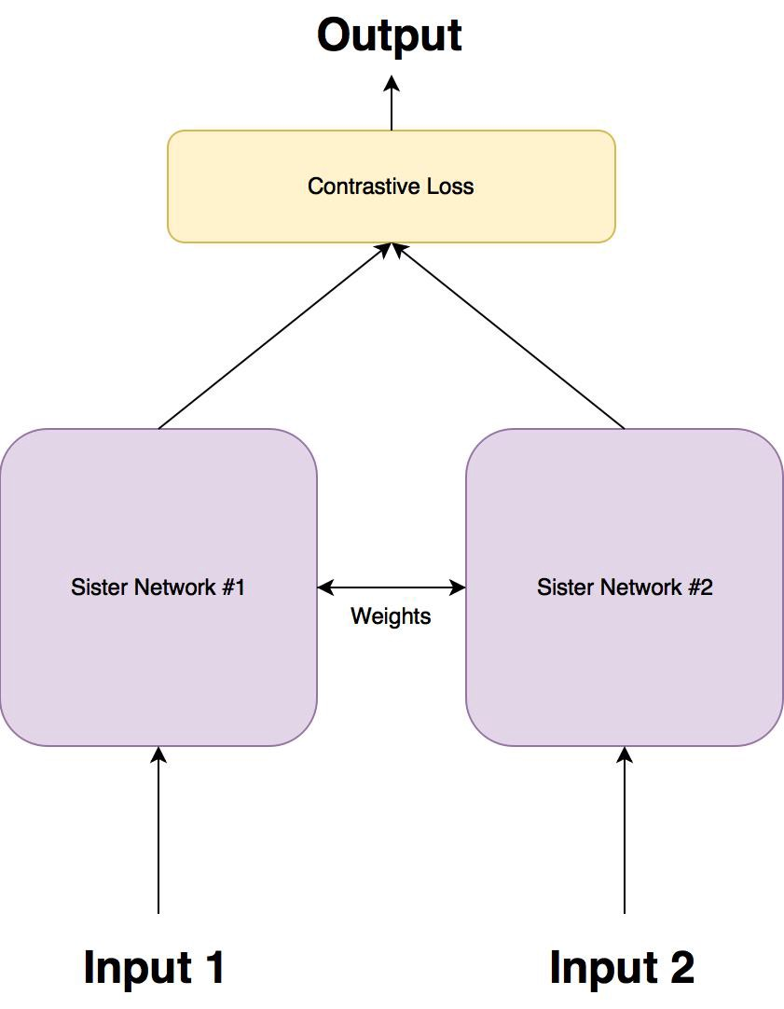
Method -- Siamese Network
Siamese network: consists of two identical neural networks, each taking one of the two input images. The last layers of the two networks are then fed to a contrastive loss function , which calculates the similarity between the two images.
Advantages:
improve accuracy when data is insufficient
fewer parameters to train for
Notes:
Siamese train result will be updated

Slide 9
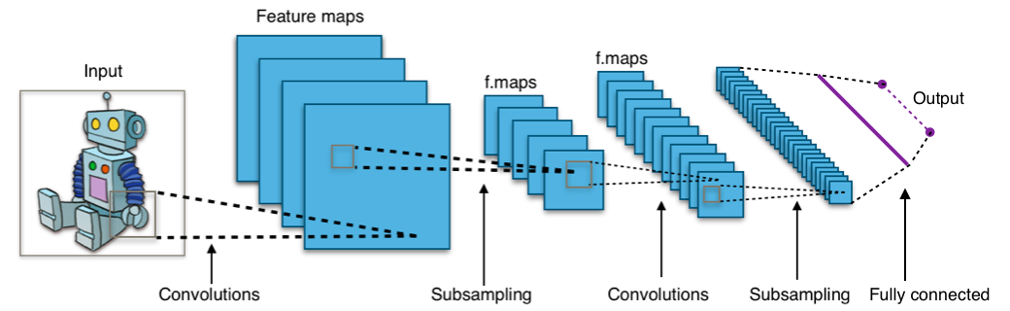
Model -- CNN Architecture
*By Aphex34 - Own work, CC BY-SA 4.0, https://commons.wikimedia.org/w/index.php?curid=45679374

Slide 10
Experiments
Pre-trained model: using tensorflow hub module
Inception V3: https://tfhub.dev/google/imagenet/inception_v3/classification/1
MobileNet V2: https://tfhub.dev/google/imagenet/mobilenet_v2_100_224/classification/2
ResNet 152: https://tfhub.dev/google/imagenet/resnet_v2_152/classification/1
Customized CNN
Car Image dataset is downloaded from Stanford database.
Pre-processing: Cropped the car from each images, and used 11 color filters to outline the contour of car.
Training: Trained the model with pre-processed images for 4000 steps.
Hardware: CPU Intel-i7 6700K@4.00MHz and GPU NVIDIA GeForce GTX 1080
Train_batch_size = 10
Validation_percentage = 10%
Learning_rate = 0.01

Slide 11
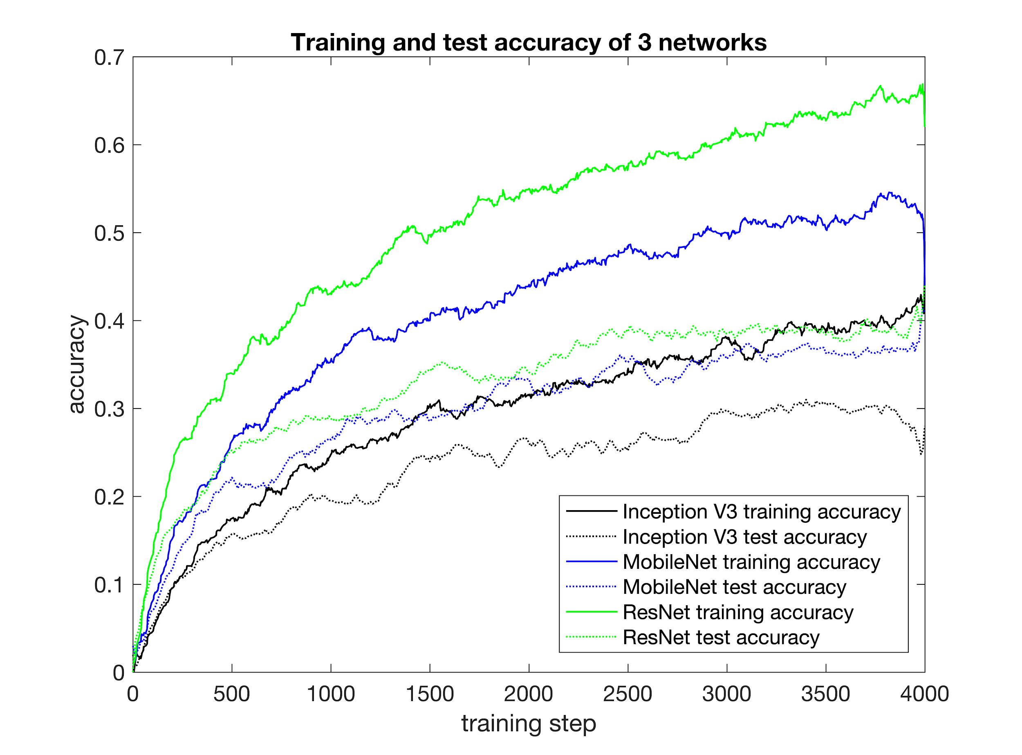
Results
Use raw dataset with 3 networks
→ ResNet has the highest accuracy: ~70%

Slide 12
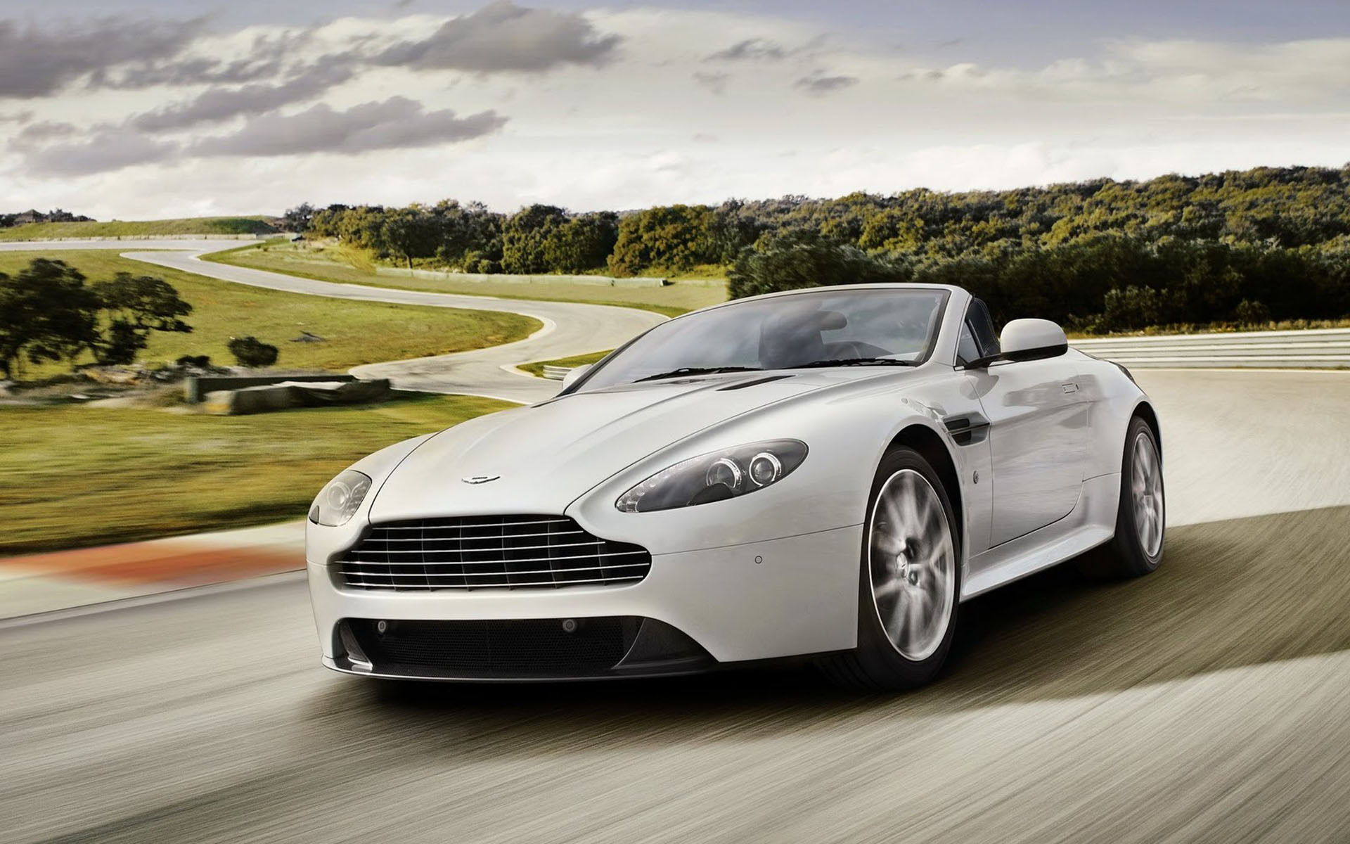
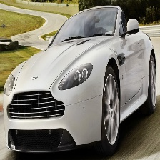
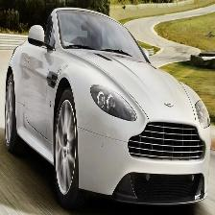
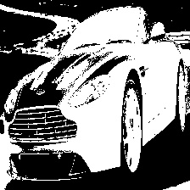
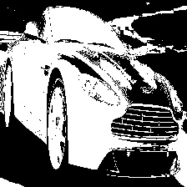
Image Pre-process
A
B
C
Raw image
Cropped image
Reflect image
Color-filtered image
Color-filtered image
D
E

Slide 13
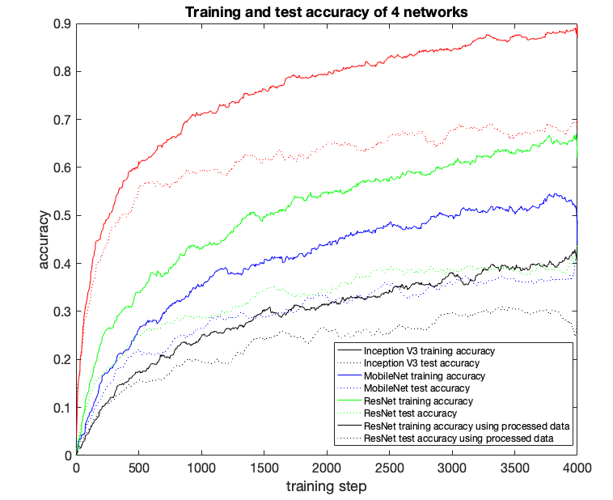
Results
2. Use pre-processed dataset(cropped and reflected) and ResNet
→ accuracy reaches ~90%

Slide 14
Conclusion
Training speed: 1000 steps/ min, on Intel-i7 6700K@4.00MHz and NVIDIA GeForce GTX 1080
Accuracy: reaches 90% above after pre-processing the data
Training step: with more training step(>20k steps), the final accuracy would stay at 92%.
Siamese network training result will be updated in paper

Slide 15
Reference
[1]Krause, Jonathan, et al. "3d object representations for fine-grained categorization." Proceedings of the IEEE International Conference on Computer Vision Workshops. 2013.
[2]Z. Chen, N. Pears, et al,” 2009 IEEE International Conference on Intelligent Computing and Intelligent Systems, Nov. 2009.
[3]L. Wang,et al, “Ridesharing car detection by transfer learning,” Artificial Intelligence, Jan. 2019.
[4]Bromley, Jane, et al. "Signature verification using a" siamese" time delay neural network." Advances in neural information processing systems. 1994.
[5]Jun Yee Ng, et al. “Image-based Vehicle Classification System”, The 11th Asia-Pacific ITS Forum and Exhibition, June. 2011

Slide 16
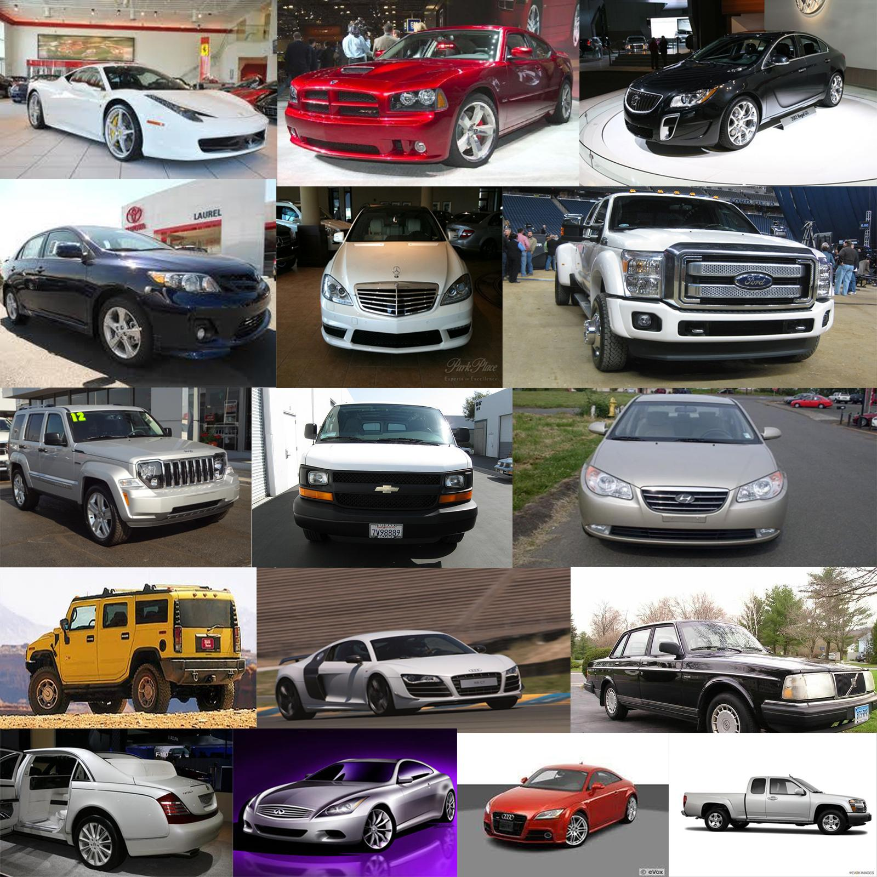
Thanks!

